Slide 1
Azure Devops DEEP-DIVE Updated 14 October 2020

Slide 2
ADODD > Agenda
Pipelines
Azure DevOps
Repos
Boards
Big Picture
Artifacts

Slide 3
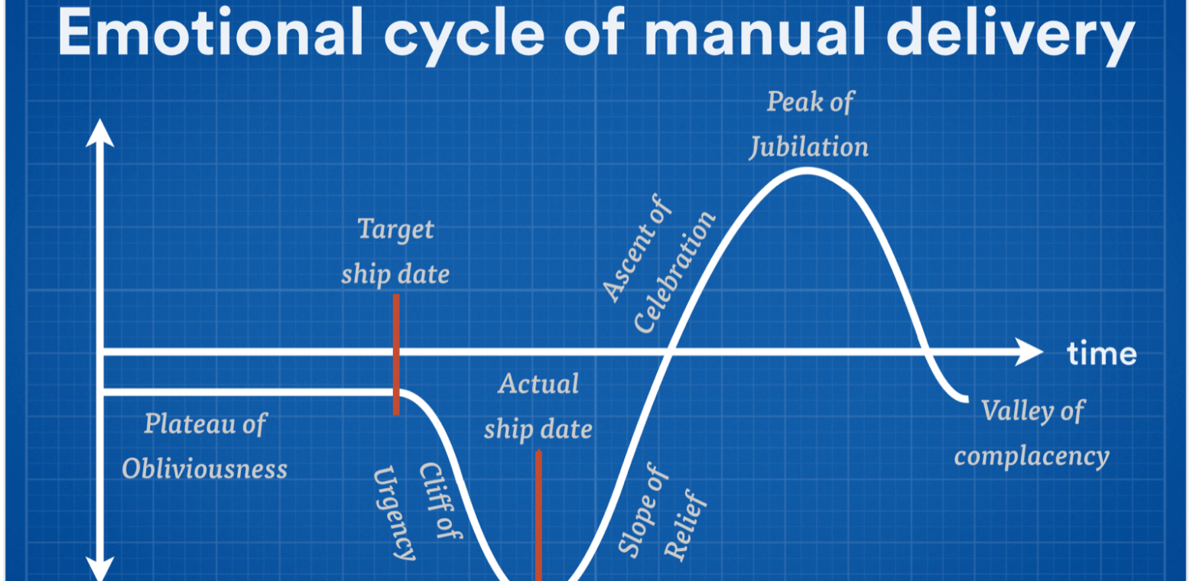
ADODD > Big Picture
Notes:
How quickly you can fail fast or double down is determined by your cycle time. Your cycle time determines how quickly you can gather feedback to determine what happens in the next iteration. The feedback that you gather with each cycle should be real, actionable data. Manual delivery increases cycle times exponentially.

Slide 4
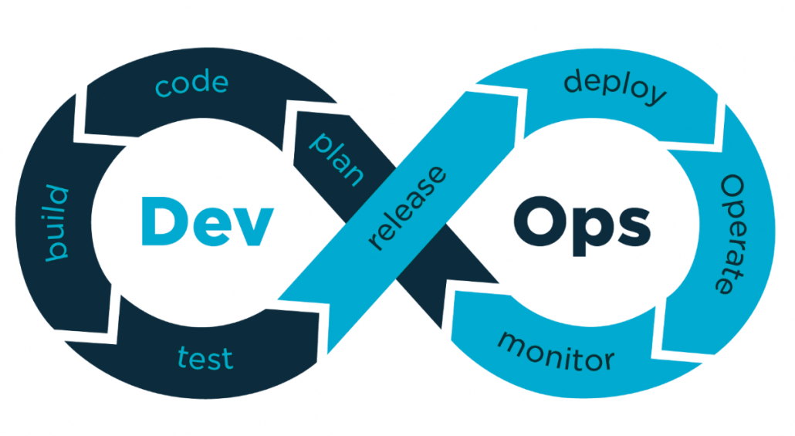
ADODD > Big Picture > DevOps
Notes:
DevOps culture stresses small, multidisciplinary teams, who work autonomously and take collective accountability for how actual users experience their software. For a DevOps team, there’s no place like production. Everything they do is about making customers’ live experience better while constantly working to reduce their cycle times.

Slide 5
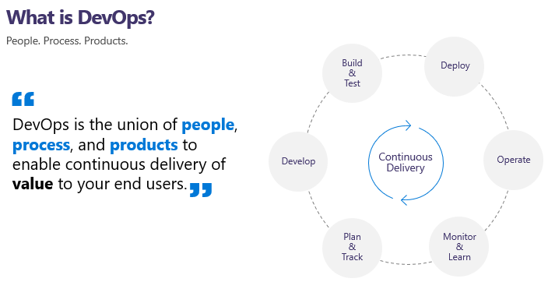
ADODD > Big Picture > DevOps
Notes:
The contraction of “Dev” and “Ops” refers to replacing siloed Development and Operations to create multidisciplinary teams that now work together with shared and efficient practices and tools. Essential DevOps practices include agile planning, continuous integration, continuous delivery, and monitoring of applications.

Slide 6
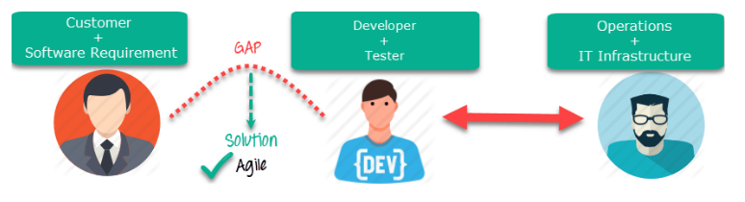
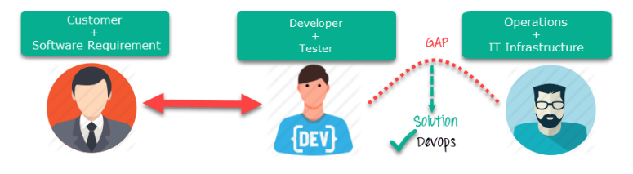
ADODD > Big Picture > DevOps
Notes:
Agile => focuses on the gap between Business and IT.
DevOps => focuses on the gap between Development and Operations.

Slide 7
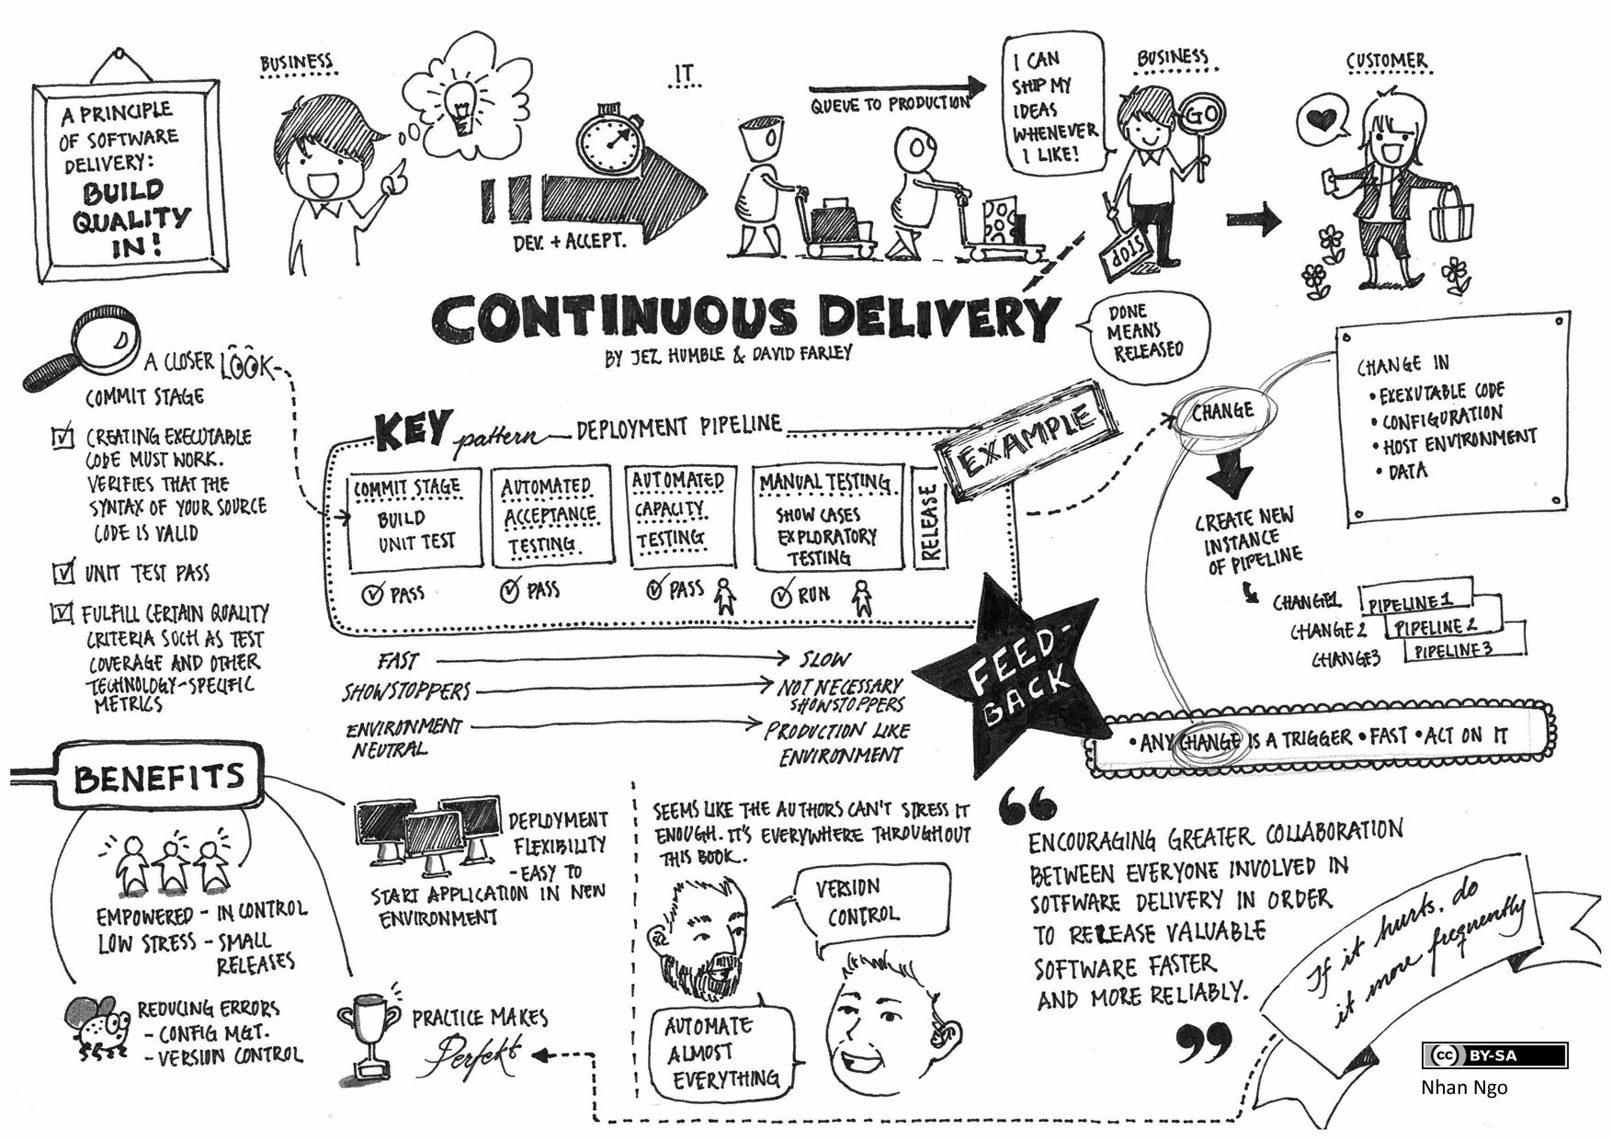
ADODD > Big Picture > Continuous Delivery
Notes:
Continuous Integration (CI) => is the process of automating the build and testing of code every time a team member commits changes to version control.
Continuous Delivery (CD) => is the process to build, test, configure and deploy from a build to a production environment.

Slide 8
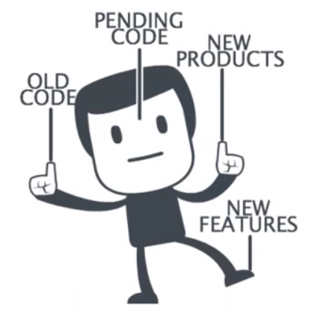
ADODD > Big Picture > Continuous Delivery > Best Practices
Build should pass in less than 5 min
Always commit small changes
Implement (and Refine) Continuous Integration
Create at Least One Stop Between Development and Production
Deploy to Every Environment the Same Way
Automate Everything

Slide 9


ADODD > Big Picture

Slide 10
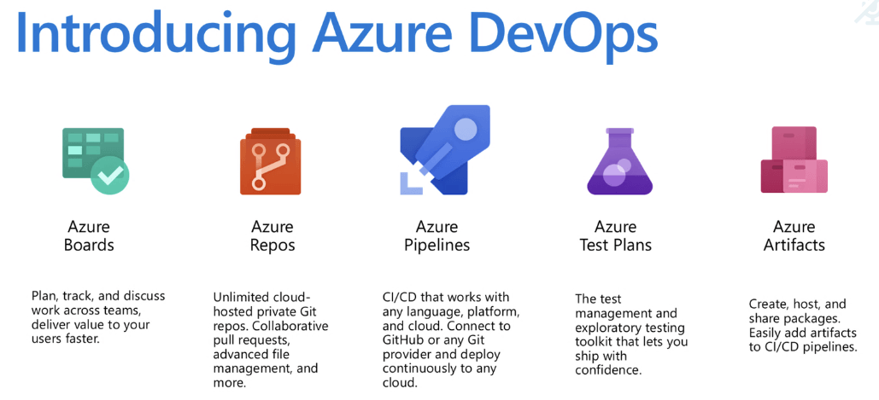
ADODD > Azure DevOps

Slide 11

ADODD > Azure DevOps > Demo
Notes:
https://docs.microsoft.com/en-us/azure/devops/cli/?view=azure-devops

Slide 12
ADODD > Azure DevOps > Projects

Slide 13
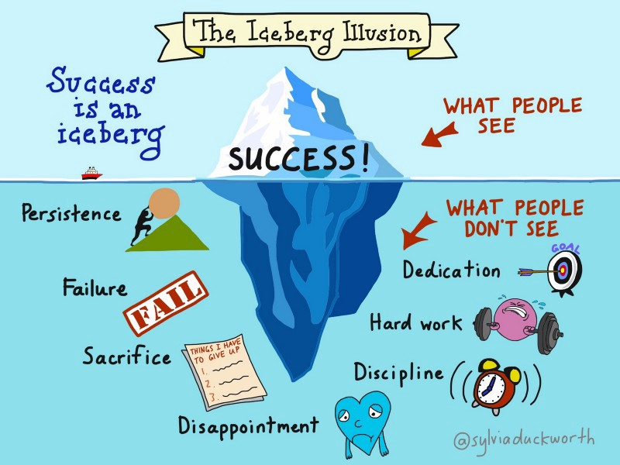
ADODD > Azure DevOps > Projects > Lab

Slide 14
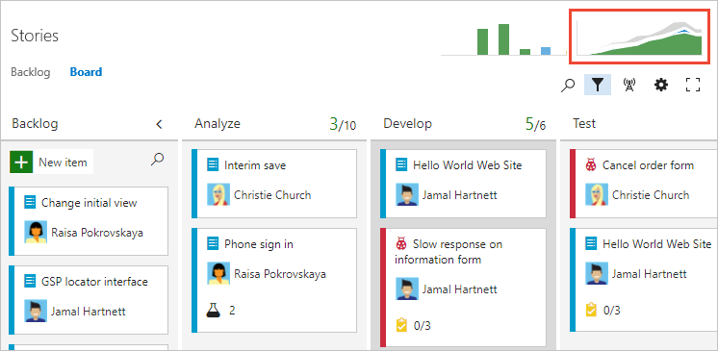
ADODD > Azure DevOps > Boards
Boards provide ”process pipelines” for work items. The primary “unit of work” in ADO
Boards uses backlogs to plan, priotize and organize work items
Boards uses sprint backlogs to manage iterations and maintain agility
Boards uses queries to list work items across projects
Notes:
What is it? => https://sec.ch9.ms/ch9/6f7f/424c1d79-4896-4b8e-9034-0aa80ecb6f7f/AzureBoards_high.mp4

Slide 15
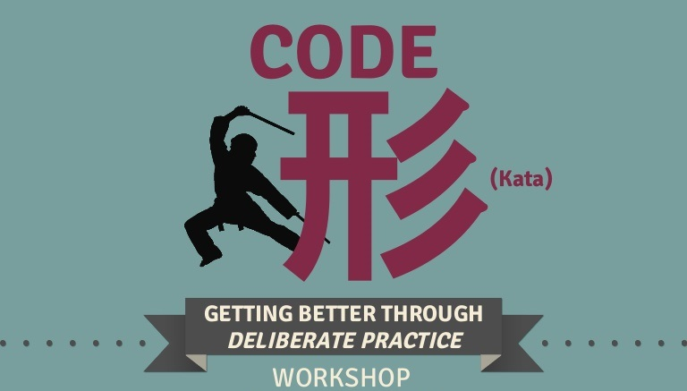
ADODD > Azure DevOps > Boards > Code Kata #1

Slide 16
ADODD > Feedback
https://airtable.com/shrDUlkEelfraVzON

Slide 17
ADODD > Literature
https://docs.microsoft.com/en-us/azure/devops/?view=azure-devops
https://docs.microsoft.com/en-us/azure/devops/learn/what-is-devops
https://www.codeproject.com/Articles/1394594/Devops-The-Big-Picture
https://www.sumologic.com/insight/continuous-delivery-best-practices/

